Slide 1


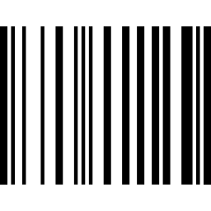




ORACLE SQL
PL/SQL
UNILAK
DATABASE PROGRAMMING · DPR400210
Warehouse
Management System
A relational database solution for accurate, efficient warehouse operations — built with Oracle SQL and PL/SQL.
Segikwiye Anord
INSTITUTION
LECTURER
SUBMISSION DATE
Registration No. 33053/2025
University of Lay Adventists
of Kigali (UNILAK)
[Lecturer Name]
15 July 2026
Notes:
OPENING — how to introduce yourself: Greet the panel ("Good morning/afternoon, esteemed panel"). State your full name (Segikwiye Anord) and registration number (33053/2025). Name the project title ("Warehouse Management System"), the course (Database Programming, DPR400210), and the technology used (Oracle SQL and PL/SQL). Give a one-sentence hook: this project replaces error-prone manual warehouse record-keeping with a relational database that tracks suppliers, products, customers and orders in real time. Tell them what you will cover and roughly how long it will take. TIP: stand up straight, speak slowly for this first slide only — nerves make people rush the introduction — and make eye contact with the panel rather than reading the slide.

Slide 2














AGENDA
Table of Contents
1
Introduction
9
SQL Implementation
2
Problem Statement
10
PL/SQL Implementation
3
Project Objectives
11
Reports
4
System Requirements
12
Oracle SQL Developer Output
5
Data Flow Diagram
13
Testing
6
Database Design
14
Challenges
7
Database Tables
15
Future Improvements
8
Entity Relationship Diagram
16
Conclusion
Warehouse Management System · DPR400210
01
Notes:
Walk through the agenda briefly — you do not need to read every line aloud. Group them verbally: "First I will introduce the problem and objectives, then walk through the database design and ER diagram, demonstrate the SQL and PL/SQL implementation, show sample reports and live output, then close with testing, challenges, and a conclusion." TIP: this slide should take under 30 seconds — it is a map, not content.

Slide 3


INTRODUCTION
What Is a Warehouse Management System?
A Warehouse Management System (WMS) is a database-driven application that controls and records the day-to-day operations of a warehouse — from goods arriving from suppliers to products being picked, sold, and dispatched to customers.
THE WAREHOUSE GOODS FLOW
Receive
Store
Manage
Dispatch
Accuracy. Every stock movement is logged as a database transaction, not a paper note.
Receive
Store
Manage
Dispatch
Efficiency. Staff query live stock levels instantly instead of walking the aisles.
Why Organizations Use a WMS
Accountability. Suppliers, orders, and customers are all traceable through relational keys.
Removes reliance on manual, paper-based stock records
Gives real-time visibility into what is in stock, low, or out
Speeds up order processing and customer service
Improves reporting for purchasing and business decisions
Warehouse Management System · DPR400210
02
Notes:
Explain in your own words what a WMS is before naming the benefits. Use the goods-flow diagram: point to each stage (Receive, Store, Manage, Dispatch) and explain that every arrow in that flow is, underneath, a SQL transaction in this project. Then cover the three benefit points on the left (accuracy, efficiency, accountability) and the "why organizations use a WMS" list on the right. TIP: this is background/context — keep it under two minutes so you have time for the technical sections.

Slide 4







THE PROBLEM
Challenges of Manual Warehouse Management
Manual Records
Paper Files
Inventory Errors
Duplicate Data
Stock Loss
Poor Reporting
Slow Searching
Human Errors
Poor Security
Difficulty Monitoring Stock
Each of these root causes traces back to one issue: data lives on paper or in disconnected spreadsheets instead of a single, validated database.
Warehouse Management System · DPR400210
03
Notes:
Do not read all ten labels one by one — cluster them into three themes as you talk: (1) data quality problems — manual records, paper files, duplicate data; (2) operational problems — inventory errors, stock loss, slow searching, difficulty monitoring stock; (3) governance problems — poor reporting, poor security, human error. Close with the summary line: all of these trace back to the absence of a single validated database. TIP: this slide sets up the "why" for every design decision in the rest of the talk — refer back to it later when you explain constraints and validation.

Slide 5
OBJECTIVES
Project Objectives
MAIN OBJECTIVE
To design and implement a relational database system, using Oracle SQL and PL/SQL, that automates and streamlines warehouse operations — inventory tracking, supplier and customer management, and order processing.
Design a normalized schema
Implement SQL scripts
Develop PL/SQL logic
Generate reports
Test and validate
Model suppliers, categories, products, customers and orders with clean relationships.
Create, populate and maintain all database tables using standard SQL.
Build a procedure and function that encapsulate core business rules.
Use queries and window functions to produce inventory and sales insight.
Confirm data integrity, constraint enforcement, and correct output.
Warehouse Management System · DPR400210
04
Notes:
Read the main objective callout first, in your own words, then move to the five specific objectives left to right — each is one sentence, so keep your spoken explanation to roughly one breath per card. Tie each objective forward to a later slide: "objective one is what you will see on the ER diagram slide," "objective three is what the stored procedure slide covers," and so on. TIP: this slide is a preview of your entire talk structure — panels appreciate seeing the roadmap stated as outcomes, not just topics.

Slide 6
SYSTEM ANALYSIS
System Requirements
Category | Requirement Details
Functional | Manage suppliers, categories, products and customers · Record and process orders · Validate stock before a sale · Generate inventory and sales reports · Rank products by sales performance
Non-Functional | Data integrity through constraints · Reasonable query performance · Straightforward usability for warehouse staff · Controlled, credentialed database access · Maintainable PL/SQL code
Hardware | PC or laptop, 4 GB RAM minimum · 20 GB free storage · Stable network connection for shared database access
Software | Oracle Database (11g / 19c / 21c XE) · Oracle SQL Developer · Windows, Linux, or macOS
User | Basic computer literacy · Valid database login credentials · Familiarity with the SQL Developer interface for administrators
Warehouse Management System · DPR400210
05
Notes:
This table separates what the system must DO (functional) from how well it must do it (non-functional), then lists the practical hardware, software and user prerequisites. Summarize rather than reading every bullet: "functionally, the system manages the five core entities and validates stock before any sale; non-functionally, the priority was data integrity and maintainable code, since this was built and tested by one developer on standard hardware." TIP: if asked "what did you assume about scale," point to this slide.

Slide 7
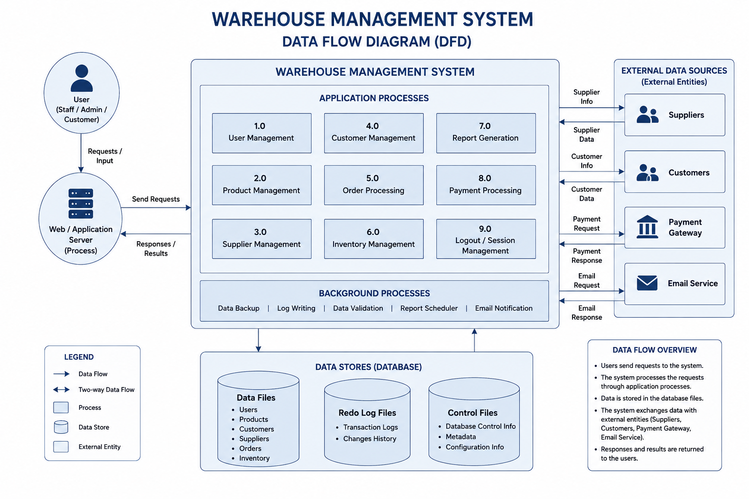
SYSTEM ANALYSIS
Data Flow Diagram (DFD)
Warehouse Management System · DPR400210
06
Notes:
This DFD shows the system one level below the ER diagram: not what data is stored, but how it moves. Walk it left to right: a user (staff, admin, or customer) sends a request through the web/application server, which routes into one of the nine application processes -- user, product, supplier, customer, order, inventory, report, payment, and session management. Point out the background processes underneath (backup, logging, validation, scheduling, email notification) running independently of any single user request, then the data stores at the bottom (data files, redo logs, control files), and finally the external entities on the right -- Suppliers, Customers, Payment Gateway, and Email Service -- that the system exchanges data with. TIP: if asked the difference between this and the ER diagram, the ER diagram models structure (what tables exist and how they relate); the DFD models behavior (how a request actually flows through the system).

Slide 8




DATABASE DESIGN
Relational Design Principles
Relational Database
Primary Keys
NORMALIZATION APPLIED
Data organized into related tables instead of flat files.
A unique identifier for every row (e.g. Product_ID).
1NF
Atomic columns — no repeating groups (e.g. one phone number per field).
Foreign Keys
Relationships
Columns that reference another table’s primary key.
One-to-many links, e.g. one supplier → many products.
2NF
Every non-key attribute depends on the whole primary key.
Normalization
Constraints & Integrity
3NF
No attribute depends on another non-key attribute (e.g. supplier address stored once, in Suppliers).
Structuring tables to remove redundancy (1NF → 3NF).
NOT NULL, CHECK and FK rules keep data valid.
Warehouse Management System · DPR400210
07
Notes:
Six core relational concepts on the left, applied normalization steps on the right. Keep definitions short and concrete — for primary/foreign keys, point forward to the ER diagram slide as the visual proof. For normalization, use the supplier-address example: storing a supplier’s address only once in the Suppliers table (not repeated on every product row) is 3NF in practice. TIP: examiners often probe normalization — be ready to justify why Products stores Supplier_ID rather than the full supplier address.

Slide 9




SCHEMA OVERVIEW
Database Tables
SUPPLIERS
CATEGORIES
PRODUCTS
CUSTOMERS
ORDERS
PK: Supplier_ID
PK: Category_ID
PK: Product_ID
PK: Customer_ID
PK: Order_ID
supplier_name
contact_person
phone, email
category_name
description
product_name, unit_price
FK: Category_ID, Supplier_ID
customer_name
phone, email, address
quantity, order_date
FK: Customer_ID, Product_ID
Warehouse Management System · DPR400210
08
Notes:
Five tables in total. Walk left to right: Suppliers and Categories are reference tables that describe where products come from and how they are grouped; Products is the central table, holding foreign keys to both; Customers holds buyer details; Orders is the transaction table linking a Customer to a Product with a quantity and date. TIP: say explicitly which columns are foreign keys here — it previews the ER diagram on the next slide and makes that diagram easier for the panel to follow.

Slide 10
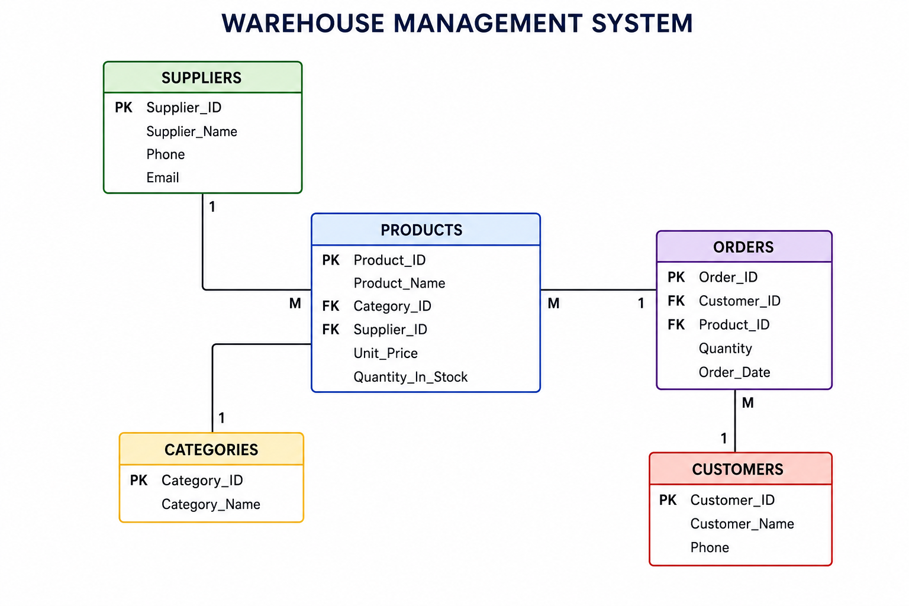
DATABASE DESIGN
Entity Relationship Diagram
How to read it: a Supplier supplies many Products (1–M); a Category groups many Products (1–M); each Order references exactly one Product and one Customer, so one Customer can place many Orders (M–1).
Warehouse Management System · DPR400210
09
Notes:
Trace each relationship out loud in order: Suppliers to Products (one supplier, many products), Categories to Products (one category, many products), Products to Orders (one product can appear on many orders), and Customers to Orders (one customer can place many orders). Point out that the "1" always sits on the reference table and the "M" sits on the side holding the foreign key, and that every FK listed inside Products and Orders matches the primary key of the table it points to. TIP: this is usually the most-questioned slide — be ready to explain what would break if a foreign key constraint were removed (orphaned orders pointing to a deleted product, for example).

Slide 11
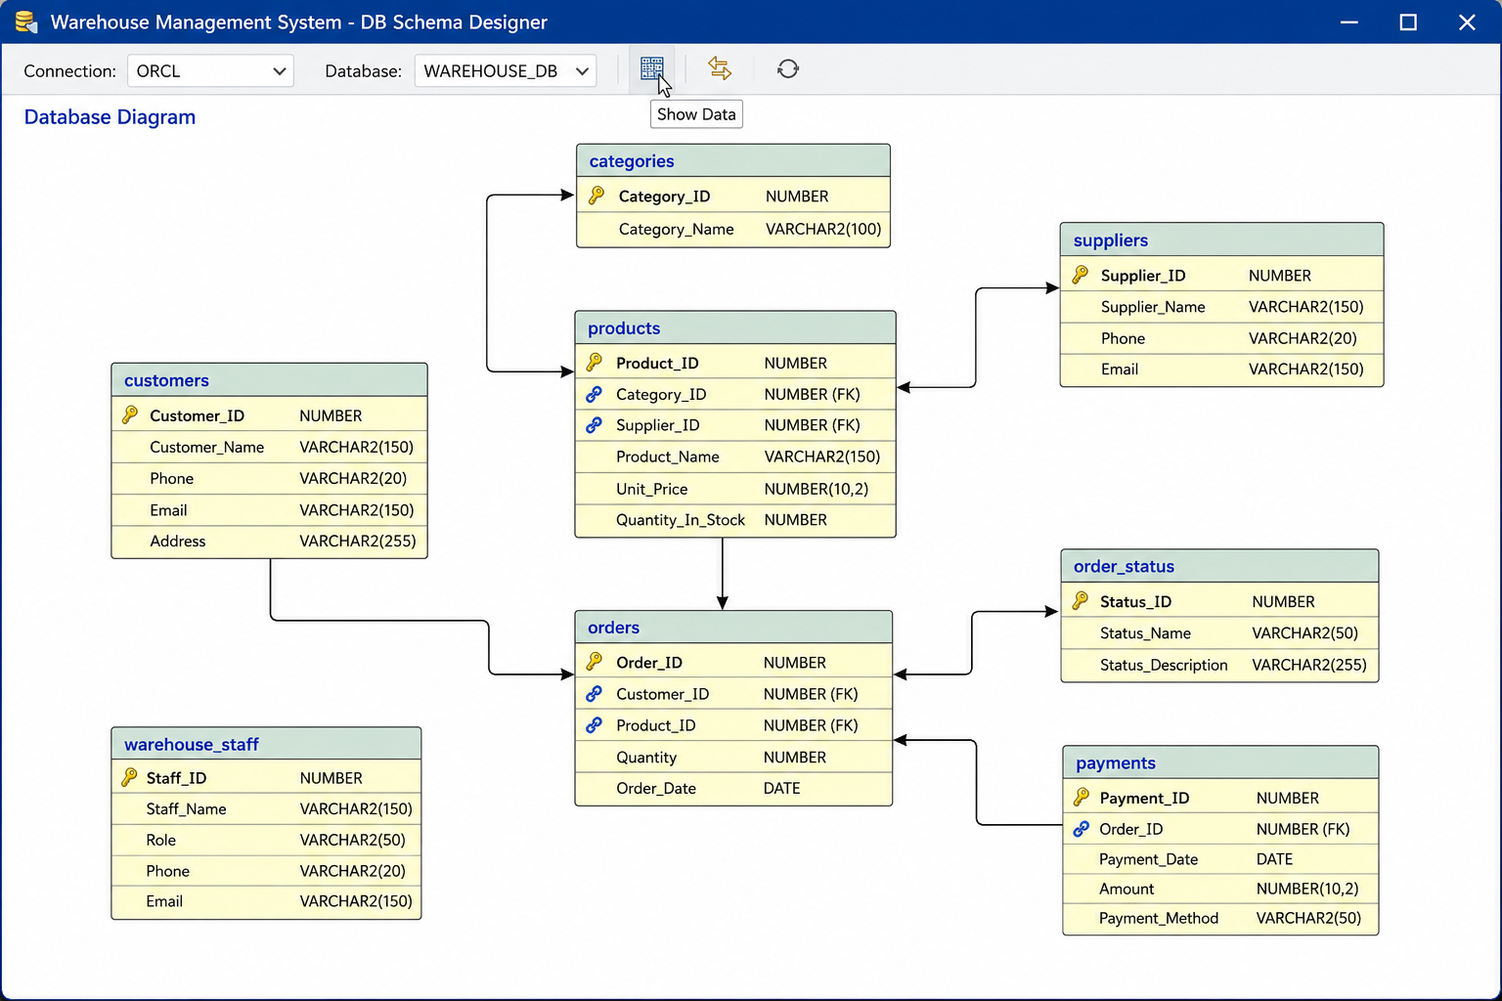
DATABASE DESIGN
Database Schema — Design Tool View
Warehouse Management System · DPR400210
10
Notes:
This is the same five-table core schema as modeled directly inside the database design tool, which is a useful screenshot to show the panel that the schema was actually built and connected, not just diagrammed on paper. It also shows three supporting tables carried in the working database -- Order_Status, Payments, and Warehouse_Staff -- which extend the core model for order-status tracking, payment capture, and internal staff accounts. Keep this brief: "the core five tables you just saw on the ER diagram map directly onto this design, plus a small number of supporting tables for order status, payments, and staff access." TIP: if asked why these three were not covered as full slides, be candid that they support the core workflow but were kept out of scope for this assignment’s PL/SQL demonstration.

Slide 12
SQL IMPLEMENTATION
Defining & Loading Data
create_products.sql
SQL TOOLKIT USED IN THIS PROJECT
CREATE TABLE Products (
Product_ID NUMBER PRIMARY KEY,
Product_Name VARCHAR2(100) NOT NULL,
Category_ID NUMBER,
Supplier_ID NUMBER,
Unit_Price NUMBER(10,2),
Quantity_In_Stock NUMBER DEFAULT 0,
CONSTRAINT FK_Product_Category
FOREIGN KEY (Category_ID)
REFERENCES Categories(Category_ID),
CONSTRAINT FK_Product_Supplier
FOREIGN KEY (Supplier_ID)
REFERENCES Suppliers(Supplier_ID)
);
CREATE TABLE — Define each of the core tables and their columns.
Named Constraints — FK_Product_Category / FK_Product_Supplier enforce links.
ALTER TABLE — Add constraints or columns after initial creation.
INSERT — Load supplier, product and customer records.
UPDATE / DELETE — Covered next — adjusting and removing rows.
insert_product.sql
INSERT INTO Products VALUES (
2001,
'HP Laptop',
1,
101,
1200,
20
);
COMMIT;
SELECT / JOIN — Covered next — retrieving and combining tables.
Constraints & Indexes — Enforce integrity and speed up lookups.
Warehouse Management System · DPR400210
11
Notes:
Show the CREATE TABLE statement and point out the two named foreign-key constraints -- FK_Product_Category and FK_Product_Supplier -- explaining that naming a constraint makes the error message readable if it is ever violated. Then show the INSERT, and explain that VALUES lists one row in exact column order, followed by COMMIT to make the change permanent. Use the checklist on the right to preview what the next slide covers. TIP: do not read every column aloud -- summarize the columns, then dwell on the two constraints, since those are what a Database Programming panel cares about most.

Slide 13
SQL IMPLEMENTATION
Querying, Updating & Deleting
select_products.sql
JOIN QUERY
SELECT
Product_ID, Product_Name,
Unit_Price, Quantity_In_Stock
FROM Products;
product_join.sql
SELECT
P.Product_Name, S.Supplier_Name, C.Category_Name
FROM Products P
JOIN Suppliers S ON P.Supplier_ID = S.Supplier_ID
JOIN Categories C ON P.Category_ID = C.Category_ID;
update_stock.sql
UPDATE Products
SET Quantity_In_Stock = 25
WHERE Product_ID = 2001;
COMMIT;
Reading These Four Statements
SELECT retrieves rows and columns without changing any data.
UPDATE modifies existing rows matched by WHERE — omit WHERE and every row changes.
DELETE removes rows matched by WHERE — the same caution applies.
JOIN combines Products with Suppliers and Categories in a single readable result.
delete_product.sql
DELETE FROM Products
WHERE Product_ID = 2010;
COMMIT;
Warehouse Management System · DPR400210
12
Notes:
Four short statements, one idea each. SELECT is read-only. UPDATE and DELETE both narrow their effect with a WHERE clause on Product_ID -- stress that omitting WHERE on either one would touch every row in the table, which is exactly the kind of mistake constraints and careful testing are meant to catch. Finish with the JOIN query, which is the same three-table pattern used throughout the reporting section. Every statement ends in COMMIT where it changes data, making the change permanent. TIP: if asked about ROLLBACK, explain it is the undo for an uncommitted change -- demonstrated properly in the exception handler on the Stored Procedure slide.

Slide 14
PL/SQL IMPLEMENTATION
Procedural Logic with PL/SQL
PL/SQL Construct | Used In This Project | Why It Was Used
Anonymous Block | Insert a product + DBMS_OUTPUT confirmation | Quick, one-off logic that does not need to be saved as a permanent object.
Stored Procedure | Sell_Product() | Encapsulates the "reduce stock on a sale" step in one reusable, parameterized call.
Function | Get_Product_Stock() | Returns a single reusable value that can be used inside any SQL statement.
Cursor | Implicit cursor inside Get_Product_Stock() (SELECT ... INTO) | Sufficient for this scope; no explicit cursor was required.
Exception Handling | Not required by the simplified procedure/function shown here | WHERE-clause matching keeps each statement safe; WHEN OTHERS + ROLLBACK is noted as a hardening step for a production version.
Packages | Not implemented in this version | Noted as a future enhancement to group related procedures and functions together.
Warehouse Management System · DPR400210
13
Notes:
This table is the map for the next four slides — each row after "Anonymous Block" through "Function" gets its own dedicated slide with code. Explain the pattern: PL/SQL lets you move logic that SQL alone cannot express — validation, branching, reusable calculations — into the database itself. Be candid about the last two rows: an explicit cursor and packages were not required at this project’s scale, and say why. TIP: examiners respect an honest "this was not needed because..." far more than an unnecessary feature bolted on to look complete.

Slide 15
PL/SQL · ANONYMOUS BLOCK
Adding a Product & Confirming It
PURPOSE
add_product.sql
A self-contained block that inserts one new product row and prints a confirmation message — demonstrating an executable statement, COMMIT, and DBMS_OUTPUT without creating a permanent object.
BEGIN
INSERT INTO Products VALUES (
2010, 'Laser Printer', 1, 101, 450, 15
);
COMMIT;
DBMS_OUTPUT.PUT_LINE(
'Product Added Successfully'
);
END;
/
BEGIN the block
INSERT the new product row
COMMIT the transaction
DBMS_OUTPUT a confirmation
SAMPLE OUTPUT
Product Added Successfully
END the block
Warehouse Management System · DPR400210
14
Notes:
Walk the flowchart on the left top to bottom while pointing at the matching lines of code on the right: the block opens with BEGIN, inserts one fully-specified row for a new product (a Laser Printer), commits the change so it persists, then confirms success with DBMS_OUTPUT. Point out that this block has no DECLARE section because it does not need a variable -- every value is supplied directly in the INSERT. TIP: mention that this same "do the work, then confirm" shape reappears inside the stored procedure on the next slide, just wrapped in a reusable, parameterized object instead of run once and discarded.

Slide 16

PL/SQL · STORED PROCEDURE
Sell_Product() Procedure
p_Product_ID
p_Quantity
sell_product.sql
CREATE OR REPLACE PROCEDURE Sell_Product (
p_Product_ID NUMBER,
p_Quantity NUMBER
) IS
BEGIN
UPDATE Products
SET Quantity_In_Stock = Quantity_In_Stock - p_Quantity
WHERE Product_ID = p_Product_ID;
COMMIT;
END;
/
Update Inventory
Reduces Quantity_In_Stock by the sold amount for the matching Product_ID.
Commit the Change
COMMIT makes the stock reduction permanent in the database.
EXECUTE PROCEDURE
execute_sell_product.sql
Call It Anywhere
BEGIN
Sell_Product(2001, 3);
END;
/
Once compiled, any block, trigger, or application can call Sell_Product(id, qty).
Result: Product 2001’s Quantity_In_Stock drops from 20 to 17.
Warehouse Management System · DPR400210
15
Notes:
This is the centerpiece of the PL/SQL section. Explain the two IN parameters, then the three-step logic on the left: the UPDATE statement subtracts the sold quantity from stock for one Product_ID, COMMIT makes that change permanent, and once compiled the procedure can be called from anywhere by name instead of retyping the UPDATE every time. Then show it being called with Sell_Product(2001, 3) and state the result. TIP: if asked what happens with an invalid Product_ID or insufficient stock, be honest that this version keeps the logic intentionally simple and relies on the WHERE match rather than explicit validation -- note that a production version would add a stock check and an exception handler before the UPDATE, as flagged on the PL/SQL overview slide.

Slide 17
PL/SQL · FUNCTION
Get_Product_Stock() Function
PURPOSE
get_product_stock.sql
Return the current stock quantity for a given product, for use directly inside SQL statements and reports.
CREATE OR REPLACE FUNCTION Get_Product_Stock (
p_Product_ID NUMBER
) RETURN NUMBER IS
v_stock NUMBER;
BEGIN
SELECT Quantity_In_Stock
INTO v_stock
FROM Products
WHERE Product_ID = p_Product_ID;
RETURN v_stock;
END;
/
INPUT
p_Product_ID — the Product_ID to look up (NUMBER).
OUTPUT / RETURN VALUE
NUMBER — the current quantity in stock for that Product_ID.
EXECUTION EXAMPLE
Function vs. Procedure — Why This Mattered
SELECT Get_Product_Stock(2001)
AS Current_Stock
FROM Dual;
A function RETURNs a single value and can be called inside SELECT, WHERE, or a report column — as shown in the execution example on the left.
Sell_Product() changes data and is called on its own, not embedded in a query, so it is a procedure, not a function.
RETURN VALUE (CURRENT_STOCK)
17
Warehouse Management System · DPR400210
16
Notes:
Walk the spec sheet on the left top to bottom — purpose, input, output — then show it executing with "SELECT Get_Product_Stock(2001) AS Current_Stock FROM Dual," returning 17 after the sale processed on the previous slide. Use the bottom-right callout to explain, in your own words, the functional difference between this function and the Sell_Product() procedure: a function hands back one value and can be embedded inside a query, while a procedure performs an action and is called on its own. TIP: this distinction is a very common viva question — have the one-line answer ready.

Slide 18

ADVANCED SQL
Ranking Products with Window Functions
product_ranking.sql
SELECT Product_Name, Quantity_In_Stock,
ROW_NUMBER() OVER (ORDER BY Quantity_In_Stock DESC) AS Row_Num,
RANK() OVER (ORDER BY Quantity_In_Stock DESC) AS Stock_Rank,
DENSE_RANK() OVER (ORDER BY Quantity_In_Stock DESC) AS Dense_Rank
FROM Products;
Product | Stock Qty | ROW_NUMBER() | RANK() | DENSE_RANK()
HP Laptop | 120 | 1 | 1 | 1
Product B | 95 | 2 | 2 | 2
Laser Printer | 95 | 3 | 2 | 2
Product D | 80 | 4 | 4 | 3
Product E | 60 | 5 | 5 | 4
Business importance: HP Laptop and Laser Printer tie on stock on hand. RANK() shows the tie honestly (2, 2, 4 — skipping 3), DENSE_RANK() keeps positions compact (2, 2, 3), and ROW_NUMBER() forces a strict order (1–5). The same pattern powers top-seller leaderboards and low-stock ranking.
Warehouse Management System · DPR400210
17
Notes:
Show the query, then walk the table row by row, pausing at the tie between HP Laptop and Laser Printer to explain it. This is the single clearest way to show you understand the difference between the three functions rather than having memorized their names: ROW_NUMBER always increments by one regardless of ties, RANK leaves a gap after a tie, DENSE_RANK does not. Close with the business use case in the callout. TIP: if asked "why not just use ROW_NUMBER everywhere," explain that it would wrongly give tied products two different ranks -- the reverse of this same ORDER BY (ASC instead of DESC) is exactly the Low Stock Report on the next slide.

Slide 19


REPORTING
Reports Generated by the System
SAMPLE REPORT QUERIES
Inventory Report
Sales Report
low_stock_report.sql
Full stock listing across all products and categories.
Orders and revenue over a selected period.
SELECT *
FROM Products
WHERE Quantity_In_Stock < 20;
Low Stock Report
Product Ranking Report
Returns every product at risk of running out, so purchasing can reorder before a stockout.
Products at or below their reorder level.
Best-sellers using RANK() / DENSE_RANK().
total_inventory_value.sql
SELECT
SUM(Unit_Price * Quantity_In_Stock)
AS Total_Inventory_Value
FROM Products;
Supplier Report
Inventory Value Report
Products and order volume grouped by supplier.
Total stock value = quantity × unit price.
Returns one number: the full warehouse’s stock value at current unit prices.
Warehouse Management System · DPR400210
18
Notes:
Six report types on the left, each backed by a SQL query already covered — Low Stock uses a WHERE clause against a stock threshold, Product Ranking uses the window functions from the previous slide, Inventory Value multiplies quantity by unit price. The two queries on the right are real, runnable examples for the Low Stock and Inventory Value reports specifically. TIP: mention that every report on this slide is just a SELECT — sometimes with a WHERE filter, sometimes with an aggregate like SUM — over the same five tables already introduced, which is exactly why a clean relational schema pays off at reporting time.

Slide 20
LIVE DEMONSTRATION
Oracle SQL Developer — Screenshot Placeholders
Created Tables
Database Connection
Products Table
Orders Table
Awaiting screenshot: SELECT table_name FROM user_tables;
Awaiting screenshot: active SQL Developer connection.
Awaiting screenshot: SELECT * FROM products;
Awaiting screenshot: SELECT * FROM orders;
Anonymous Block Output
Stored Procedure Output
Function Output
Window Function Output
Awaiting screenshot: DBMS_OUTPUT from the stock-check block.
Awaiting screenshot: sell_product() executing successfully.
Awaiting screenshot: get_product_stock() returning a value.
Awaiting screenshot: ROW_NUMBER / RANK / DENSE_RANK result set.
Inventory Report
Sales Report
Low Stock Report
Total Inventory Report
Awaiting screenshot: inventory report query output.
Awaiting screenshot: sales report query output.
Awaiting screenshot: products at or below reorder level.
Awaiting screenshot: total inventory value calculation.
Warehouse Management System · DPR400210
19
Notes:
These twelve boxes are placeholders only — no fabricated screenshots have been inserted. Before presenting live, replace each dashed box with an actual Oracle SQL Developer screenshot showing that exact output. During the defense, either present this slide with real screenshots pasted in, or switch to a live SQL Developer session and narrate each result as you run it. TIP: rehearse the live run beforehand so no query errors happen in front of the panel — have a fallback screenshot for every box in case the connection drops.

Slide 21
QUALITY ASSURANCE
Testing Summary
Feature | Test Case | Expected Result | Actual Result | Status
Insert Product | Insert a new product record | Record inserted with a valid Product_ID | Record inserted successfully | Passed
Sell Product | Call Sell_Product(2001, 3) on an in-stock item | Quantity_In_Stock decreases by the sold quantity | Stock decreased from 20 to 17 as expected | Passed
Update Stock | Update stock after a supplier delivery | Quantity_In_Stock reflects the new value | Quantity updated correctly | Passed
Generate Report | Run inventory / low-stock report queries | Accurate, correctly formatted output | Report generated as expected | Passed
Window Function | Run RANK() on Quantity_In_Stock | Products ranked correctly, ties handled | Ranking returned correctly | Passed
Function | Call Get_Product_Stock() with a valid ID | Returns the correct current stock | Correct value returned | Passed
Procedure | Call Sell_Product() a second time on the same product | Quantity_In_Stock decreases again on each call | Stock decreased from 17 to 14 as expected | Passed
Warehouse Management System · DPR400210
20
Notes:
Seven test cases, one per core feature, each confirmed passing. Do not read every cell — pick two rows to narrate in detail: "Sell Product" (because it is the core business action, tracing a stock value through an exact before/after change) and "Procedure" (because calling it twice confirms it behaves consistently on repeat calls, not just once). State that every test passed, which sets up the conclusion. TIP: if asked what happens on an invalid Product_ID, be honest that this simplified procedure relies on the WHERE match rather than explicit validation — link back to the "hardening step" note on the PL/SQL overview slide.

Slide 22

LESSONS LEARNED
Challenges Faced During Development
Oracle Installation
Foreign Keys
Configuring Oracle Database and SQL Developer took several attempts.
Keeping referential integrity across five related tables required careful sequencing.
PL/SQL Debugging
Procedure Errors
Tracing errors inside procedures was harder than debugging plain SQL.
Compilation errors in Sell_Product() needed repeated correction.
Constraint Violations
Learning Window Functions
Test data occasionally violated CHECK and FOREIGN KEY rules.
ROW_NUMBER, RANK and DENSE_RANK were new concepts to master.
Data Relationships
Outcome
Mapping real warehouse relationships into a normalized schema took iteration.
Resolved through lecture material, official docs, and hands-on testing.
Warehouse Management System · DPR400210
21
Notes:
Pick two or three of these to genuinely elaborate on rather than reading all eight — Oracle installation and PL/SQL debugging are usually the most relatable. Being candid about real difficulty (and how it was solved) reads as more credible than claiming a flawless build. Close on the "Outcome" card to pivot positively into Future Improvements. TIP: panels often ask "what was hardest" directly — have your honest answer ready before you reach this slide, not improvised on the spot.

Slide 23







WHAT'S NEXT
Future Improvements
Barcode Scanner
QR Code Tagging
Cloud Database
Mobile Application
Authentication
Admin Dashboard
Reports Dashboard
Notifications
Email Alerts
AI Inventory Prediction
Warehouse Management System · DPR400210
22
Notes:
Ten forward-looking ideas, grouped verbally into three themes: input speed (barcode scanner, QR tagging), access and reach (cloud database, mobile app, authentication), and operations intelligence (dashboards, notifications, email alerts, AI-based demand prediction). None of these were required for this assignment — frame them as a genuine roadmap, not missing work. TIP: keep this section brief; the panel is grading what you built, not what you plan to build.

Slide 24
CONCLUSION
Conclusion
All five project objectives were achieved — from schema design through PL/SQL logic to reporting.
The system replaces manual, error-prone stock-keeping with a validated relational database.
Core PL/SQL concepts were demonstrated: an anonymous block, a stored procedure, a function, an implicit cursor, and window functions.
The database was implemented, populated, and tested end-to-end in Oracle SQL Developer.
All DPR400210 assignment requirements were fulfilled, with every test case in the testing summary passing.
This project shows that a well-normalized schema, paired with disciplined PL/SQL, turns a manual warehouse into a reliable, queryable system.
Warehouse Management System · DPR400210
23
Notes:
Deliver this slide as a confident summary, not a re-read of the bullets — you are telling the panel what they just watched you prove, not introducing new information. Land on the closing statement in the navy panel as your final sentence before moving to questions. TIP: pause for a beat after this slide; do not rush straight into "Thank you" — let the conclusion land before you close.

Slide 25
THANK YOU
Questions?
Warehouse Management System
Segikwiye Anord · Reg. No. 33053/2025
DPR400210 — Database Programming · UNILAK
Oracle SQL · PL/SQL · Oracle SQL Developer
UNILAK
Notes:
CLOSING: thank the panel for their time and attention, then invite questions directly: "Thank you — I am happy to take any questions." If a question is unclear, ask them to repeat or clarify rather than guessing. If you do not know an answer, say so honestly and offer to follow up, rather than improvising a wrong answer about the database. Keep the Oracle SQL Developer session or backup screenshots ready in case a question asks you to demonstrate something live. TIP: breathe, keep the same steady pace you used in the introduction — the Q&A is scored too, not just the slides.

